Slide 1
SAP FI
Accounts Receivable

Slide 2
Table of Contents
  AR Overview
  Sub Processes
    Master Data
    Credit Management
    Invoice Processing
    Cash Receipting / Payments
    Account Analysis / Reconciliation
    Periodic Processing
    Reporting

Slide 3


SAP Modules - Overview
SD
FI
Sales &
Distribution
Financial
Accounting
MM
CO
Materials
Mgmt.
Controlling
PP
AM
Product
Planning
Fixed Asset
Mgmt.
SAP R/3
QM
PS
Quality
Mgmt.
Project
System
PM
OC
Plant Maint.
Office &
Comm.
HR
IS
Human
Resources
Industry
Solutions

Slide 4
FI – Financial Accounting Modules
FI - Financial Accounting Modules
General Ledger
GL
Special Ledger
Accounts Payable
AR
SL
AP
Legal
FI
Accounts Receivable
Consolidation
LC
AR
TM
CM
Travel
Management
AM
&
IM
Cash Management
Asset and Investment
Management
Notes:
Page <number>

Slide 5
Accounts Receivable Process Overview
Financial
Accounting
Process decompositions are the starting point for our process documentation.
They summarise what is involved in a the AR process at a high level
Accounts Receivable
Master
Data /
Credit Management
Invoice
Processing
Cash Receipting / Payments
Account Analysis & Reconciliation
Periodic
Processing
Reporting

Slide 6
Master Data
Maintenance
  Creation 3 Levels
    General Data (name, address)
    Company Data (reconciliation acct, payment term)
    Sales Data (SO currency, incoterms)
  Change
  Block
  Delete
Account Groups
Intercompany
One-time customers
Notes:
Page <number>

Slide 7
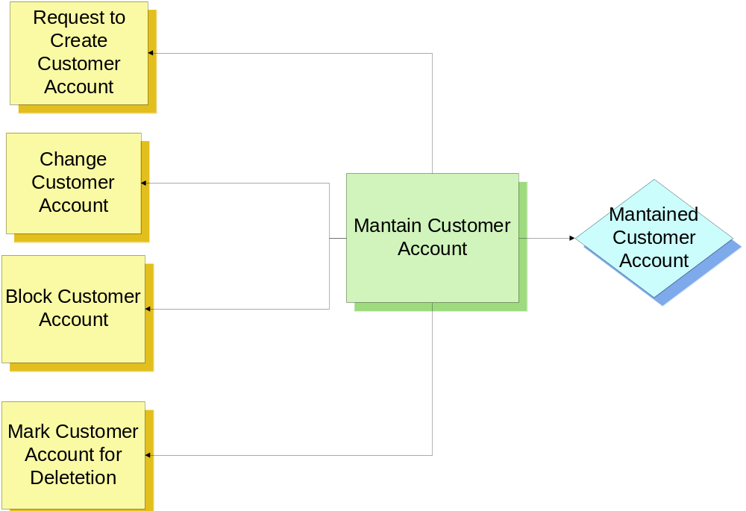
Master Data – Activity Flow
Notes:
A Ltd has decided to maintain Master Data centrally.

Slide 8
Master Data: Structure
General data
  Address
  Control data
  Marketing
  Export data
  Contact persons
Company Code data
  Account Management
  Payment Transactions
  Correspondence
  Insurance
Sales Area data
  Sales
  Shipping
  Billing document
  Partner functions
Client
230
Customer
Master
Company
Code 9100
A Ltd
Sales Organization
9100
Notes:
Page <number>

Slide 9
Components of a Customer Master
Customer Master Data contains:
General data
  Does not depend on the company code or the sales and distribution organisation
  Applies to one business partner for all company codes, and in all sales areas, and includes:
    Company name
    Address
    Telephone number
  Data that is unique to a customer, and shared by all departments

Slide 10
Components of a Customer Master 2
Company Code data
  Company code data only applies to one company code (Legal business). This data is only relevant to Financial Accounting.
  If you edit a master record, you must specify the customer number and company code to access the screens containing company code data.
  You can only invoice a Payer (partner function) if you have entered data in the Financial Accounting view.

Slide 11
Components of a Customer Master 3
Sales and Distribution data
  The data for one customer can differ for each sales area. The sales area is a combination of Sales Organization, Distribution Channel and Division. Some data is only relevant to Sales and Distribution, and includes:
    Pricing data
    Delivery priority
    Shipping conditions
  If you edit a customer master record, you must enter the customer number and the sales area in order to access screens containing sales and distribution data.
  You can only process sales and distribution transactions, eg: a sales order, after entering the sales and distribution data for a customer.

Slide 12
Master Data: Partner Functions
Sold-to party*
Ship-to party*
Partner functions
Sales Territory
Payer*
Sales Agent
Bill-to party*
Contact persons
* mandatory functions
Notes:
Page <number>
A business partner is a person or an organization with whom you have a business relationship. The system automatically creates one ship-to party, bill-to party, and payer when you create a new sold-to party record.
The partner function describes the relationship you have with that business partner. For example, the business partner can be a:
Sold-to party who places an order.
Ship-to party who receives the order.
Bill-to party is simply the address on the invoice.
Payer who is responsible for paying the invoice and records this payment in their books.
Additional partner functions and business partners can be added to the customer master records. You can define alternative ship-to parties, bill-to parties and payers records for a sold-to party. This allows, for example, one sold-to party to place an order for more than one ship-to location yet have another location receive the invoice.
A customer master record must be created for an alternative partner using the correct account group. For example, an alternative ship to party is created using account group 0002 (Ship-to Party).
A customer master record must be created for an alternative partner using the correct account group. For example, an alternative ship to party is created using account group 0002 (Ship-to Party).

Slide 13
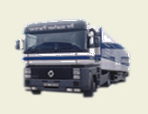

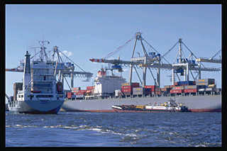
Master Data: Account Groups
Sold-to Customer
Groups Implemented
0001
Sold to
0002
Ship to
0003
Payer
0004
Bill to
One-Time Customer
CPD
One-time
Ship-to Customer
ZAF1
Plant / Affiliate
ZSWP
Swap Partner
Notes:
To create a master record, you have to specify an account group. The account group cannot be changed after you created the master record.
The account group determines:
How the account is numbered.
A number interval from which the account number is chosen,
Which fields are displayed when you create or maintain Customer master data and whether the entry is optional or required (field status) when you enter or change Customer master data. E.g. when setting up an Employee as a Customer, purchasing data is not required.
Whether the account is a one-time account.

Slide 14
Number Ranges for Account Groups
Internal Assignment: SAP assigns a unique number each time a master record is created
External assignment:User creating the master record can enter their own unique number
Account
Group
Partner
Function
Number
Range
Number
Assignment
0001
0002
0003
0004
CPD
ZAF1
ZOTR
Z002
Z007
ZSWP
Sold-to
Ship-to
Bill-to
Payer
One-time
Plant / Affiliate
Sales Territory
International SH
Sales Agent
Swap Partner
0010000000 – 001999999
0010000000 – 001999999
0010000000 – 001999999
0010000000 – 001999999
0020000000 – 002999999
0000000001 – 0000019999
A – ZZZZZZZZZZ
0010000000 – 001999999
A – ZZZZZZZZZZ
1000000000-1999999999
Internal
Internal
Internal
Internal
Internal
External
External
Internal
External
External
Notes:
Page <number>
If internal numbering is assigned to an account group, then SAP R/3 will automatically assign an internal number within the defined interval.
Most customer master records created in SAP R/3 will be created using account group 0001 (Sold-to Party)
If external numbering is assigned, then the user must enter a number within the defined interval.
The last number issued (internally or externally) is displayed by clicking on the Account group Overview button

Slide 15
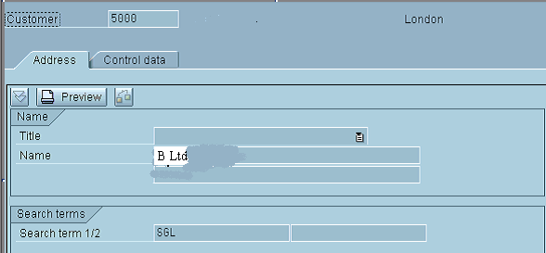
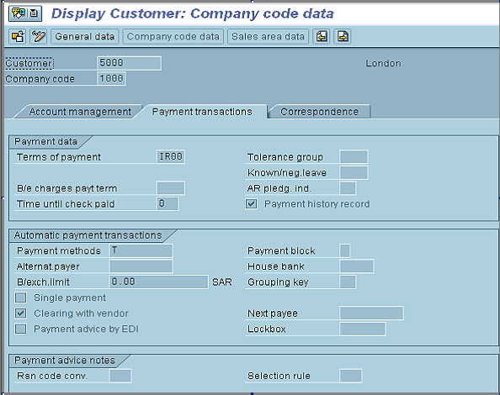
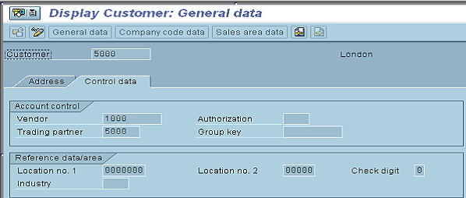
Master Data: Intercompany
Notes:
Page <number>

Slide 16

Master Data: One-time Customer
We use One-time Customer’s Master Record to avoid large number of unnecessary master data
Every time we enter a business transaction, the systems stores the specific Master Data information separately in the document
Notes:
One-time Customers are used for Customers with whom we rarely or only once perform business with.
In contrast to other Customer master records, a one-time Customer master record is used for several Customers, so that you do not have to create a large number of Customer master records that are used only once. As a result, you do not store any Customer-specific data in the Customer master record for one-time accounts.
When you post an invoice to a one-time account, SAP R\3 automatically goes to a master data screen. In this screen, you enter the specific master data for the Customer, e.g. name, address, which is stored separately in the document.
You create, display, block, and delete one-time Customer master records in the same way as all other Customer master records.
The sort key used for One-Time Customers is 023

Slide 17
Managing Customer Master Data
Blocking / Unblocking
  For processing at various levels:
    Sales order processing
    Delivery processing
    Billing processing
  Credit control reasons
  Requires validation
Block Customer
Master record
New customer
Credit Control
Block / Unblock
Notes:
Depending on the reasons for blocking a customer master record, you can select all sales areas or only a specific sales area.
If a sales area is not entered in the initial screen, then SAP R/3 assumes that the master record is to be blocked for all sales areas.
A customer master record can be blocked for:
sales order processing
delivery processing
billing processing

Slide 18
Managing Customer Master Data (2)
Flag for deletion
  For processing at various levels:
    Sales order processing
    Delivery processing
  Duplication of data
  Redundancy of use
Delete Customer
Master record
Duplication of
customer master
Redundant
records
Flag for deletion
Notes:
Customer master records can be flagged for deletion:
If there is a duplication of records for a sales organization of for the company as a whole
Redundancy of use
Once the records have been flagged for deletion, then the relevant person within the sales organizations affected, must be notified.

Slide 19
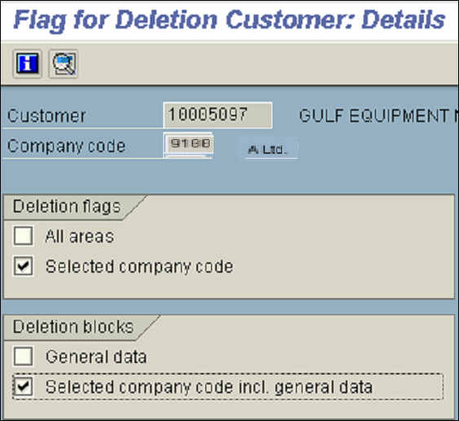
Deleting a Customer Master Record
Delete all areas
or data for a specific CC
Prevents SAP from deleting
the general data or company
code and general data
Notes:
Page <number>

Slide 20


Deleting a Customer Master Record
SAP
Database
Customer
master
record
Block
Flag
Placed
In a file
No longer used /
created in duplication
Transferred to
archive system
Extracted from
database
Pre-requisites for archiving a record:
  The account cannot contain any transaction figures
  Transaction figures from prior years that have not been archived will prevent the system from deleting the account master record
  The account must be marked for deletion in its master record
Notes:
Customer master records that are no longer used or have been created in duplication should be archived by flagging them for deletion.
Archived records are extracted from the SAP database, deleted and placed in a file and then transferred to an archive system.
To archive a record, the following prerequisites must be met:
The account cannot contain any transaction figures in the system
Transaction figures from prior years that have not been archived will prevent the system from deleting the account master record
The account must be marked for deletion in its master record
Block an account for posting before you mark it for deletion. The only effect this deletion indicator has is to cause a warning to be issued every time someone tries try to post to this account.
You can reset a deletion flag at any time as long as the master record has not been physically deleted from the system.

Slide 21
Credit Management - Overview
Credit Management can minimize the credit risk by defining specific credit limits for your customers
This is particularly useful if your customers are in financially unstable industries or companies, or if you conduct business with countries that are politically unstable
You can specify your own automatic credit checks based on a variety of criteria
You can also specify at which critical points in the sales and distribution cycle (for example, order entry, delivery, goods issue) the system carries out these checks

Slide 22

Credit Management
Credit Control Area
  A hierarchical unit for managing customer credit limits
  A credit control area can include one or more company codes
  If a customer is created in several company codes that are assigned to different credit control areas, a separate credit limit is managed for the customer in each of the different credit control areas
9400 – Latin America
9100 - Asia Pacific
9200 - America
9300 – Middle East
Notes:
Each credit control area carries out credit control for one or more company codes and, to enable it to do this, you must assign the respective credit control area to the company codes

Slide 23
Global Credit Control
CHQ
Overall Credit Limit: $1,000,000
Individual limit: $450,000
Credit Control Areas
9400 – Latin America
Limit: $250,000
9100 – Asia Pacific
Limit: $150,000
9200 – America
Limit: $150,000
9300 – Middle East
Limit: $450,000
Company Codes
9400
9401
9402
9100
9200
9300
9301
Notes:
Credit control areas are defined at regional level.
A central credit control limit will be defined at CHQ
The individual limits for each credit control area may not exceed the total at group level e.g. $1,000,000
The maximum individual limit is defined at group level e.g. $450,000
Some companies e.g Exon Mobil can be managed at the group level. The credit limits will be defined at group and individual credit control area

Slide 24
Credit Management: Data Views
Central Data
  Contains information for the current credit limit assigned and maximum permitted credit limits
    Total amount
    Individual amount
Status
  Credit limit data - Contains information relating to credit limits and percentage used:
    Receivables
    Special liabilities
    Sales value
  Internal data - Contains information relating to the customer risk category and blocking a customer for all transactions excluding billing

Slide 25
Credit Management - Exposure
Credit Exposure
  The customer's credit exposure may not exceed their credit limit
  The credit exposure is the total combined value of the following documents:
    Open orders
    Open deliveries
    Open billing documents
    Open items (accounts receivable)
Executing automatic credit check in sales order processing
  Non-critical fields
    Not re-executed for changes made to these fields e.g. Texts
  Critical fields:
    Re-executed for changes made to critical fields e.g. Payment terms, Price, quantity
Notes:
A customer’s credit exposure is the total combined value of the following documents:
Open orders (Sales orders not yet delivered)
Open deliveries (Deliveries not yet invoiced)
Open billing documents (Not yet posted to Financial Accounting)
Open items (accounts receivable) (Forwarded to FI, but not yet cleared)

Slide 26
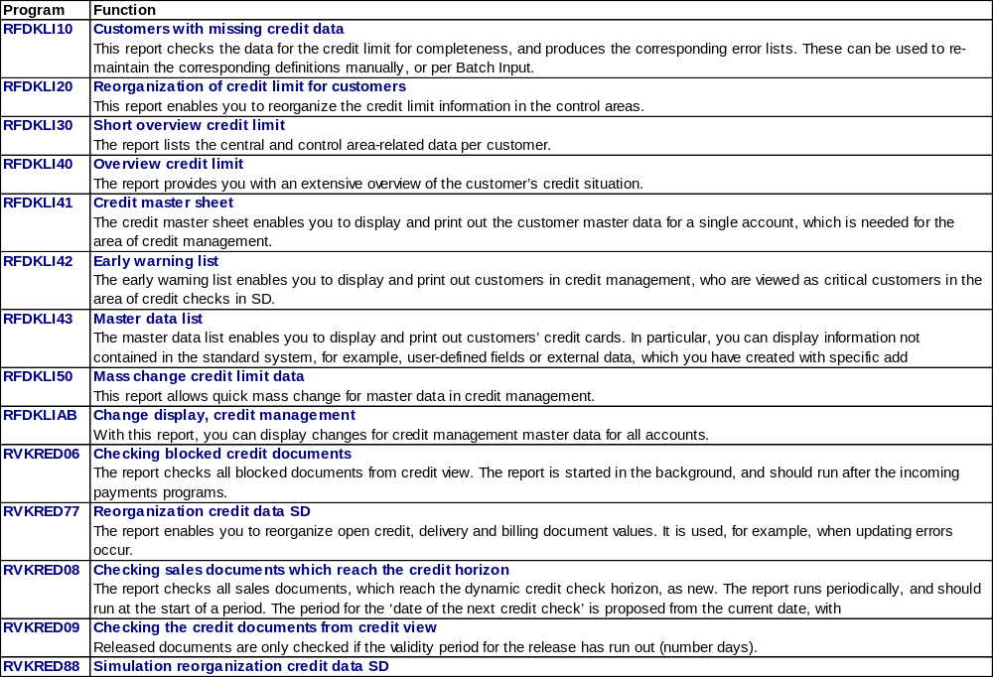

Credit and Risk Management - Reports

Slide 27
Accounts Receivable Process Overview
Financial
Accounting
Process decompositions are the starting point for our process documentation.
They summarise what is involved in a the AR process at a high level
Accounts Receivable
Master
Data /
Credit Management
Invoice
Processing
Cash Receipting / Payments
Account Analysis & Reconciliation
Periodic
Processing
Reporting

Slide 28

Invoice Processing
SAP R/3 supports the following transactions:
Sundry
  Invoice
  Credit/Debit Notes
  Down Payment
  Bill of Exchange Receivable
Parked Documents
Foreign Currency
SD Billing
Inter-company postings
Notes:
Page <number>

Slide 29
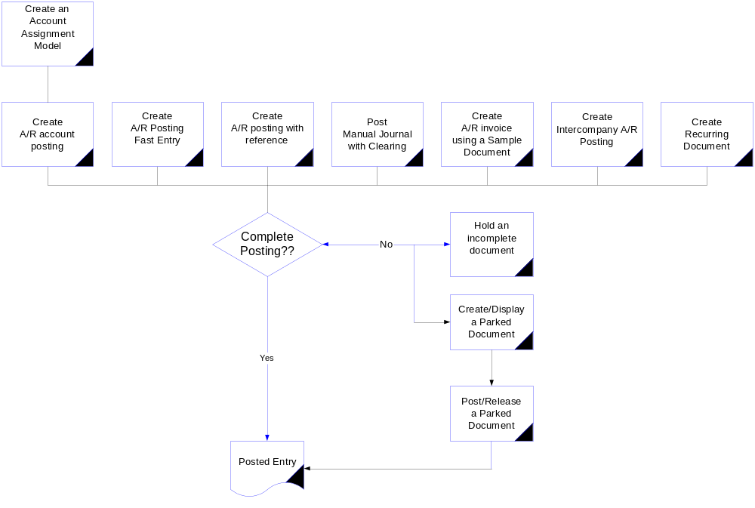
Sundry Invoice Processing
Notes:
Page <number>

Slide 30
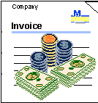

Posting a document
After entering the document it is possible:
  To post it immediately
  To “park” the document
  To hold the document
Document
Simulation

Slide 31
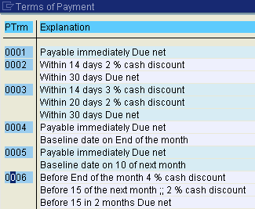
Payment Terms
Terms of payment are arrangements made with a Customer governing financial settlement with respect to goods supplied and services performed, e.g. cash on delivery, payment within 30 days.
Within payment terms, cash discounts and periods allowed for payment are defined.
Notes:
If the invoice is blocked, the payment terms will go as usual. No effect on payment terms.

Slide 32
Document Creation with Reference
Document
13 000 00031
______
______
______
______
Sample Document
92 000 00044
______
______
______
______
or
Reference _______________
Doc. Number ?
Control Sequence____________
• Generate Reverse Posting
• Enter G/L Account Items
• Do Not Propose Amounts
• Display Line Items
Document
13 000 00032
______
______
______
______

Slide 33
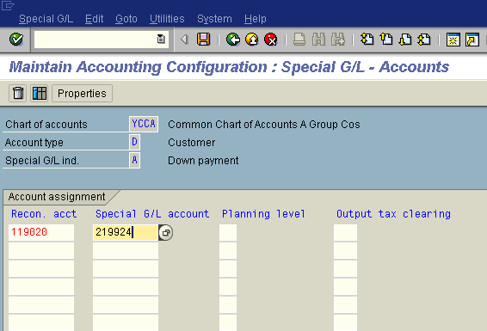
Special GL Transactions: Definition
Special GL Indicator
Accounts defined for Special GL Transactions
Customers’ reconciliation accounts
Special GL Transactions allow the user to post the document to an alternative GL account instead of “normal” Customer’s reconciliation account,
They are defined in Customizing for Customers and Customers reconciliation accounts.

Slide 34
Posting a Down Payment
Customer’s Account
GL Down Payments
Bank Account
10
1
10
1
10
The Customer pays A Ltd a down-payment: $10.000,-
The down payment is booked on Customer’s account with Special GL indicator
The amount of $10.000,- is shown on Customer’s account, but on different GL Account, instead of Customer’s reconciliation account
Notes:
Except of “normal” special GL transactions, in the system there may be defined “noted items”. If the special GL transaction is defined as “noted item” than postings with this indicator do not lead to an update of the transaction figures. Typical example is “Down Payment Request”: a posting done with this indicator stores only an information in the system that is used later to post automatically a down payment.

Slide 35
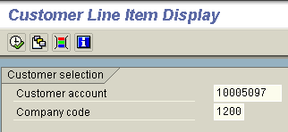
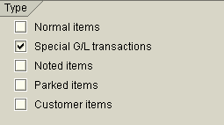
Display of Special GL Transactions
To display the transaction posted with Special GL Indicator, mark the relevant field on the “Line items display” screen.
“Dynamic selections” may be used to search for different GL indicators.

Slide 36
Effect of Creating a Billing Document
Sales Order Processing
Inventory Sourcing
Invoice
Invoice
Customer Payment
Delivery & Shipping
Billing processing
Updating the document flow
Creating documents in Financial Accounting
Updating the billing status
Updating the Sales Information System
Updating the credit account
Forwarding data to Profitability Analysis
Printed document / EDI to customer
Notes:
Page <number>
The billing document is the final process that is performed in the Sales cycle in the sales and distribution module.
The creation of a billing document has the following effects:
Document flow and document statuses are updated
Documents are automatically created in Financial Accounting and Controlling that update the general ledger account for revenue
The Sales Information System is updated
Accounts receivable is increased
The customers credit record / limit is decreased
Controlling elements such as profitability analysis and profit centre accounting are update

Slide 37
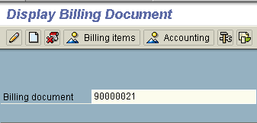
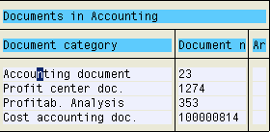
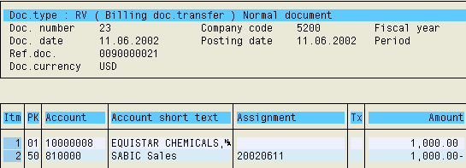
Billing Document
Notes:
In display mode, no changes can be made to a billing document.
When a billing document is created, the system automatically creates all the relevant accounting documents for:
General ledger
Profit center
Profitability Analysis
Cost Accounting
Accounting

Slide 38
Credit and Debit Memo Requests
Billing
doc.
Credit memo request
Credit note
Billing block
Create credit memo
after billing block has
been removed
OK
Billing
doc.
Debit memo request
Debit note
No billing block
Create debit memo
Notes:
Page <number>
Credit and debit memo requests are created by referencing the invoice.
The system transfer the correct amount from the preceding document.
Enter an order reason (reason for adjustment) for evaluation purposes.
The credit memo request is automaticall blocked for billing, whereas the debit memo request does not contain a billing block.
Once approved, the billing block is removed and a credit note is created.
The credit memo request has a credit check assigned to it, which will block the credit memo request for further processing if the customer has credit problems.
During posting of the billing documents (credit memo or debit memo), accounting documents are created which posts the correct amounts against the customer's A/R account.

Slide 39
Inter-company Processing
Inter-coy Billing
AR header reference
=
AP header reference
Invoice (IV)
SD Document
2000002244
HDR Ref:
2000002244
A Ltd.
AP
Inter-coy Billing
AR
Invoice (IV)
SD Document
1000001144
HDR Ref:
1000001144
A1 Ltd
F110
FI Document
3000015244
HDR Ref:
2000002244
AP
AR
A2 Ltd.
FI Document
2000006344
HDR Ref:
1000001144
F110
AR header reference
=
AP header reference

Slide 40

Parked Documents
Enter an
incomplete
document
Complete and post later
Park document
No postings take place
Line items
Display/change/evaluate
parked documents
Documents
Post parked documents
Postings take place
MM
Customer
G/L account
Notes:
Page <number>
You can enter an invoice (or a credit memo) without posting it and simply "park" it. You enter the data in the system and save it in a document. The system does not, however, make any postings.
A parked document can be changed as often as you like. When data is added or changed, the changes are noted by the system. When no further changes are required, you can post the parked document. Only then does the system carry out the normal account movements and make the necessary updates.
The preliminary posting function can be of great advantage if:
You are interrupted when entering an invoice. You can park the document and continue processing it later on. This saves you time having to enter the data twice.
You wish to clear up some questions before you post an invoice. You can park the document and continue processing it later on.
You wish to split the invoice verification process. One employee can, for example, park an invoice without checking it, while another carries out the actual checks and posts the document after making any necessary corrections.

Slide 41


Parked doc. vs. Held doc.
Parked document:
  Assigned number (according to document type)
  Document is available for editing for many users (depending on the authorizations in the system)
Held document:
  Internal document number (defined by the user)
  Document is available for editing only for the user who created it.

Slide 42
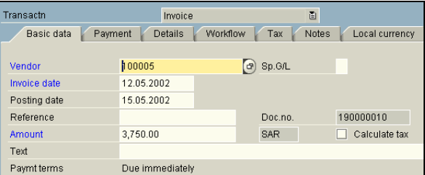
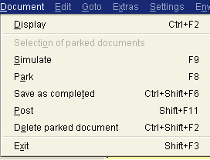
Processing of Parked Documents
Choose company code
The parked document may be:
  Posted,
  Edited,
  Saved as completed,
  Deleted.
Notes:
If you know the parked document’s details, enter the document number, company code and fiscal year on the Initial screen.
Alternatively, click the List button, which takes you to a selection screen. On the Document List screen, enter the selection criteria, then click the Execute button

Slide 43
Posting in Foreign Currency
Local currency - Functional currency of the company code
Document currency - Currency of the document
Group currency - Alternative currency for group reporting
For every Company Code there’s defined a company code currency, ie, every company code has a “local” currency.
Every document, posted in different currency than company code currency, is processed as a foreign currency document.
Accounting documents can be posted in a foreign currency
The foreign currency is converted to local currency and both are stored in the document along with the exchange rate

Slide 44
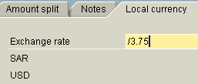
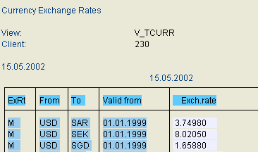

Posting in Foreign Currency
1.
2.
3.
1. Exchange rate can be entered manually,
2. Or derived from “Exchange Rates Table”
System automatically translates the foreign currency into CC currency.
Notes:
When you post a invoice in a foreign currency, you enter the appropriate foreign currency key in place of the local currency key, USD that is defaulted by the SAP R/3. The system stores the amount in both local currency and foreign currency in each line item and checks whether the currency key has been defined and is therefore permitted.
The amount is entered in only one currency, as the system translates this amount into the other currency automatically.
Normally you will use the exchange rate defined in the exchange rate table.
If the exchange rate on the invoice is different than default daily rate the currency exchange rate table can be overridden by entering an exchange rate manually (in the document header), or entering the local/foreign currency amount at line item level.

Slide 45
Accounts Receivable Process Overview
Financial
Accounting
Process decompositions are the starting point for our process documentation.
They summarise what is involved in a the AR process at a high level
Accounts Receivable
Master
Data /
Credit Management
Invoice
Processing
Cash Receipting / Payments
Account Analysis & Reconciliation
Periodic
Processing
Reporting

Slide 46
Cash Receipting / Payments
Business Transactions included in Process:
Customer Payments
  Manual Checks
  Clear Customer Accounts
  Post processing transactions
Inter-company Payments
  Idoc’s

Slide 47
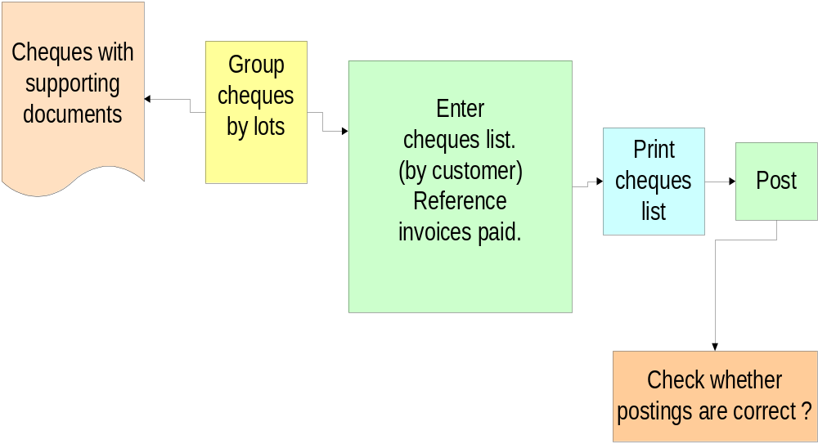
Manual Check Deposit - Activity Flow

Slide 48


Check Deposit - Account Assignment
Check Deposit List
Postings
Customer Account
O.b.) 200,-
200,- (1
Incoming checks Account
1) 200,-
200,- (2
Bank Account
2) 200,-
Notes:
To process checks manually:
1. Enter checks. Remember to include clearing information: in A Ltd as a clearing information was chosen Customer short name and an invoice number (from SD Module). Create a batch input session or choose direct processing.
2. Run the sub-ledger session. Postings to bank clearing accounts (incoming checks) and to sub-ledger accounting (customer clearing).
3. Print the check deposit list and give it to the bank, along with the checks.
4. Process the bank postings.

Slide 49
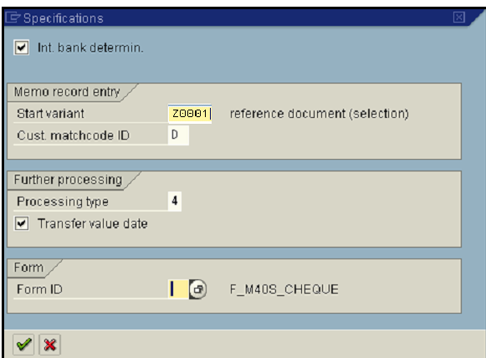
Check Deposit - Initial Specification
House Bank ID
Customer Matchode
Postprocessing method:
2 - batch input
4 - direct posting (on-line)
Notes:
This is the start variant and determines which fields are displayed when you are actually entering checks. You can change the account assignment variant at any time during processing.
If you select internal bank determination, the system identifies the bank using the internal name instead of the bank number and external account number. You can use either, according to what is usual in your company.
The match code ID D and the contents of the customer match code field on the next screen make up the match code of the customer account the system searches for (account determination for payment settlement).
The further processing type determines whether the postings in the batch input session are made online or in the background.
Transfer value date: The value date from the check entry is copied into the postings.
Specify a form ID if you want to use a form that differs from the standard form for the check deposit list.
For A Group we use start variant Z0001

Slide 50
Check Deposit - Posting
Posting
Processing type 2
Batch Input
Direct Posting
Processing type 4
Process
Process
Log
Log
Notes:
The postings can be done immediately or processed in the batch input sessions.
The Post option generates postings immediately or the batch input sessions, including postings for sub-ledger accounts.
You can process the sessions individually or together, online or in the background (batch).
The log displays the processing statistics and any incorrect transactions.
Incorrect transactions, which were not processed due to inadequate clearing information, must be post processed:
If you are using batch input sessions, you must run these again online.
If you are using immediate postings, you need to use a transaction FEBA to clear the open items.

Slide 51
Accounts Receivable Process Overview
Financial
Accounting
Process decompositions are the starting point for our process documentation.
They summarise what is involved in a the AR process at a high level
Accounts Receivable
Master
Data /
Credit Management
Invoice
Processing
Cash Receipting / Payments
Account Analysis & Reconciliation
Periodic
Processing
Reporting

Slide 52
Account Analysis / Reconciliation
Business Transactions included in Process:
Display Customer’s account balance and line items
Clear outstanding items on Customer’s
Post Customer’s documents with clearing
Perform automatically clearing procedures
Reverse documents
Notes:
Page <number>

Slide 53

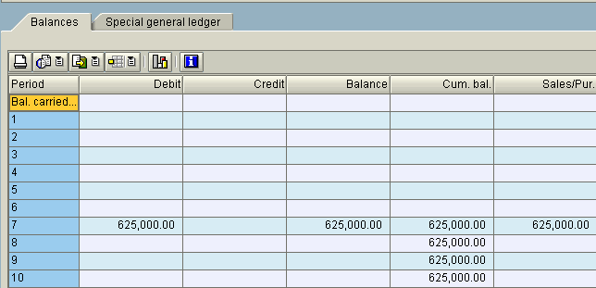
Display Account Balance
Account balance displays totals of transactions, per month as well as cumulative values
The report may be printed or saved as a local file

Slide 54

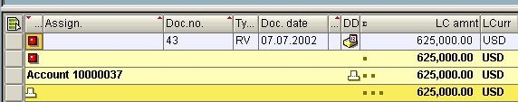
Display Account Line items
“Line items” report displays particular transactions,
It it possible to change the documents directly from this screen,
The report may be printed or saved as a local file

Slide 55
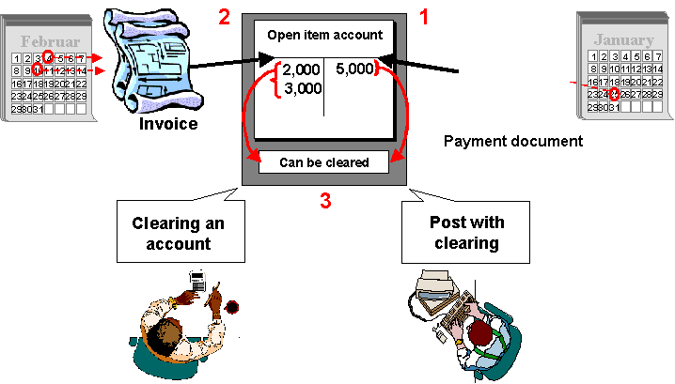

Open Item Clearing
1
2
3
Notes:
Page <number>
Open items are incomplete transactions, such as an invoice for which goods or services have not yet been received.
In order for an open item transaction to be considered complete, the transaction must be cleared. A transaction is considered cleared when an offset value is posted to it, so that the resulting balance of the items is zero.
In the above example:
Two invoices are posted to the Customer account. These invoices are regarded as the open items because at this point the corresponding payment has not been received.
The payment is received and the invoices are set off against it.
The transaction is now cleared and the resulting balance is zero.

Slide 56
Clearing: Customer and Vendor
1 Customer invoice 46,000
2 Customer invoice 20,000
3 Customer payment 26,000
Customer ABC Inc.
Customer ABC Inc.
1 46,000 46,000 3
3 20,000 20,000 2
Bank
3 26,000
Notes:
Page <number>
If you select a Customer who is also a Vendor when processing a clearing transaction, such as an incoming/outgoing payment or account maintenance, the system will also select the open customer items automatically, provided that:
The vendor number was entered in the Customer master record.
The “Clearing with Vendor / Customer” indicator has been set in both master records.
When posting payments to these Customers, the system will display the vendor open items in addition to the Customer open items.
You must have authorisation to post in both Accounts Receivable and Accounts receivable transactions, in order to clear vendors and Customers against each other.

Slide 57
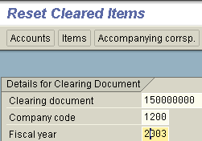
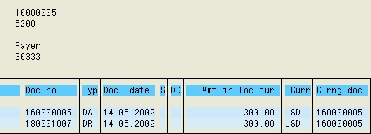
Reversal of Clearing
Display cleared items
Reversal of clearing
Reversal of documents that were cleared before is not possible,
First the clearing operation must be reset.

Slide 58
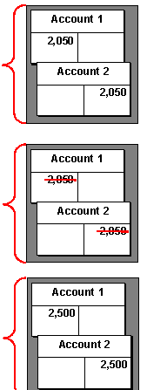
Reverse a Customer document
Document entered incorrectly
Document corrected by Reversal:
  Reverse with a standard reversal posting
  Reverse with a negative posting
  Document re-entered correctly
Balance sheet
Assets
Liabilities
Shared equity
Notes:
“Nobody’s perfect”. As a result, the document created may contain incorrect information.
The system provides a function to reverse G/L, A/R and A/P documents both individually or in mass process.
A document may be reversed either by:
entering a standard reversal posting or
entering a negative posting.
To reverse a document user must enter the reason code.
Documents with cleared items cannot be reversed. The clearing document must first be reset.
To enable negative postings, you need to set the relevant indicators: for the company code and a relevant document type.

Slide 59
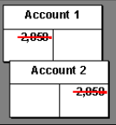
Mass Reversal of Documents
Mass Reversal Procedure
Many documents may be reversed at the same time,
Process may be scheduled to be performed in the background.

Slide 60
Accounts Receivable Process Overview
Financial
Accounting
Process decompositions are the starting point for our process documentation.
They summarise what is involved in a the AR process at a high level
Accounts Receivable
Master
Data /
Credit Management
Invoice
Processing
Cash Receipting / Payments
Account Analysis & Reconciliation
Periodic
Processing
Reporting

Slide 61
Period End Processing
Business Transactions included in Process:
Dunning
Notes:
Page <number>

Slide 62
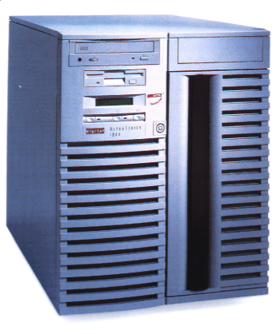

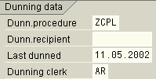
Dunning - Process Overview
Customer Open Items
Update
Dunning Program
Print Dunning Notices
Customer Master Record
Update

Slide 63
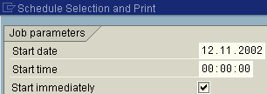
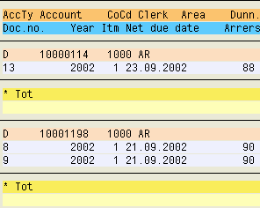
Dunning Proposal
Schedule Dunning Run
Check / Edit Dunning Proposal
The dunning run creates a dunning proposal which can be edited, deleted, and recreated as often as necessary.
If desired, the dunning run can directly and automatically be followed by the printing of dunning notices. The editing of the dunning proposal would therefore be skipped.
As a general rule, receivables are due at the net due date.

Slide 64
Dunning Blocks
Dunning
Block
0001
Customer Master
OR
Line Items
You can prevent customer invoice from dunning. There are two ways to to it:
  You can enter a dunning block in the item (e.g. customer invoice); then the system puts this item on the blocked items list and this items is not included in the dunning notice.
  You can enter a dunning block in the customer master. In such case the system does issue a dunning notice at all for this account.

Slide 65

Dunning Levels
Dunning Levels
A Ltd dunning procedure has three dunning levels.
The higher the dunning level the more insistent is the dunning text.
Each item to be dunned gets a dunning level according to its days in arrears.
From one dunning run to another the dunning level can only be raised by one, i.e. no dunning level can be skipped.

Slide 66
Print Dunning Notices
3
1
2
Print Notices
Schedule
printout
Check Spool Request(s)
The print program for the dunning procedure:
  generates dunning notices,
  enters the dun date and the dunning level into the dunned items (e.g. invoices) and customer master records.
If one-time customers are dunned, the dunning data is only updated in the items.
Dunning notices are printed in a sequence defined by sort criteria.

Slide 67
Accounts Receivable Process Overview
Financial
Accounting
Process decompositions are the starting point for our process documentation.
They summarise what is involved in a the AR process at a high level
Accounts Receivable
Master
Data /
Credit Management
Invoice
Processing
Cash Receipting / Payments
Account Analysis & Reconciliation
Periodic
Processing
Reporting

Slide 68
Reporting
SAP system offers number of reports that help analyzing entered business transactions:
  Open Items List
  Cleared Items List
  Account List
  Account Balance List
Customised Reports
  Aged Open Items List
Report can be:
  Printed out directly to the printer,
  Saved as a local file (txt format, Excel file etc.)
  Sent by e-mail
Notes:
Additionally, SAP offers a number of reports that meet country-specific requirements. There is a list of country-specific reports for completing VAT tax forms and reports for additional legal reporting requirements

Slide 69
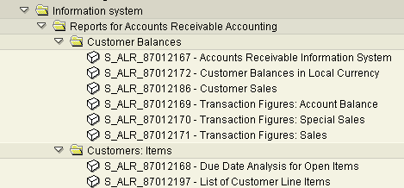
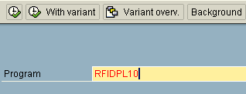
Accessing Reports
1
SAP Menu
2
Transaction SA38
A user can run the required report in two ways:
  Directly from “The Report Tree”,
  Using transaction SA38, provided that he/she knows the report’s name

Slide 70
Accounts Receivable Evaluations
Evaluation Views
Company code
- Corporate group
Variable
Business area
- Company code
Country
- Business Area
Planning group
Due date analysis
Currency analysis
Overdue items
Recon. Acct.
Versions
Evaluation types
Notes:
Page <number>
The accounts receivable information system enables you to access different evaluations already defined in the system. Because these evaluations are stored in an information database, system response times are accelerated.
The results stored in the information database are based on the last evaluation carried out. You can update the evaluations at regular intervals.
In customizing, there are defined various parameters for selecting and summarizing evaluation data according to your own needs.

